Slide 1


Implementation and Functional Verification of Communication Protocols
Review 3
Major Project
Project ID: Alpha 7 & V15
AY 2021-25
GITAM (Deemed-to-be) University
Department of Electrical Electronics and Communication Engineering
Project Team:
Sunkara Venkatesh -BU21EECE0100308
Poluru Sai Chaithanya - BU21EECE01002008
Gurram Chethan Sree Royal - BU21EECE0100529
Project Mentor:
Dr S Karthick
Project In-charge:
Dr Ambar Bajpai
www.gitam.edu

Slide 2
Objective and Goals
Objective
To implement I2C, SPI, UART, CAN and FLEX RAY communication protocols using Verilog.
To evaluate key performance metrics such as data transfer rates, latency, and transfer interference for the implemented communication protocols.
To propose optimized configurations for protocols, enhancing communication efficiency, scalability, and reliability for Software Defined Vehicles (SDVs).
Goals
Design and Implementation: To design and implement the CAN, I2C, UART, SPI and Flex Ray communication protocols in Verilog, ensuring each protocol meets industry standards for data transfer, signal integrity, and timing.
Simulation and Validation: To simulate the functionality of each protocol and validate their performance through waveform analysis, ensuring reliable data transmission, real-time communication, and error detection.
Functional Verification: To verify the functionality of CAN, I2C, SPI, UART and Flex Ray communication protocols and efficient hardware utilization, and compliance with industry standards for timing and reliability.

Slide 3


Project Plan
Gant Chart - Milestones and Activities
Milestone #5
Milestone #2
Milestone #3
Project Implementation and Review 1 – Jan 8
Final review for Phase 1
Project Implementation
Milestone #4
Sign Off
Kick Off
July 22
Extended(Phase 2) Abstract - Dec 22
Review 2
Checkpoint A
Feb
Milestone #1
March 28 2025
abstract –Aug 8
Submitted report and PPT
2018
July-2024
August
October
November
December
January
February
March-2025
2019
8 days
Today
Project completion
ESCI 2025 Conference - March 5-7 presentation
Awarded as Best paper of session
24 days
100%
Jul 22 - Nov 24
Preparatory Phase 1
Conference Paper Accepted in ESCI 2025- JAN 15
34 days
Conference Paper Submitted DEC-31
Phase 2 Work Effort
100%
23 days
Aug 03 - Sep 7
35 days
Testing Phase
100%
Sep 1 - Sep 17
31 days
Preparatory Phase 2
100%
Dec 15 - Mar 25
Delivery Phase
100%
Sep 8 - Sep 30
Phase 2 Work Effort
100%
Jan 4 - Feb 7
Testing Phase
100%
Mar 15 - Mar 25
Delivery Phase
100%
Jan 24 - Feb 27

Slide 4
Literature Survey (Improved post minor project)
Key Publications
Presented a research paper at the 7th IEEE International Conference on Emerging Smart Computing and Informatics (ESCI-2025) and received the Best Paper Award for the session. The study focused on the development and validation of communication protocols implemented in Verilog using Xilinx Vivado, ensuring reliable data transmission and adherence to communication standards. The paper is currently pending publication.
Existing Implementations – Products| Opensource| GitHub etc
Design and Implementation of Flex Ray using Xilinx Vivado in Verilog.
Design and Implementation of UART Communication Protocol using Xilinx Vivado.
Design of UART protocol over FPGA

Slide 5
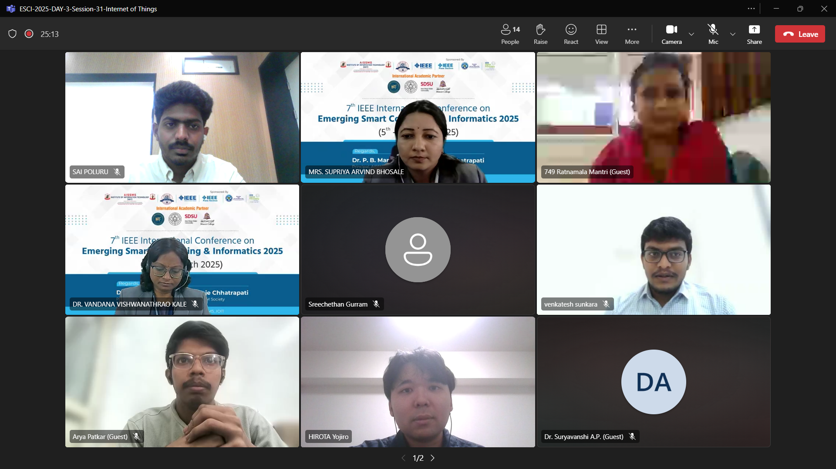
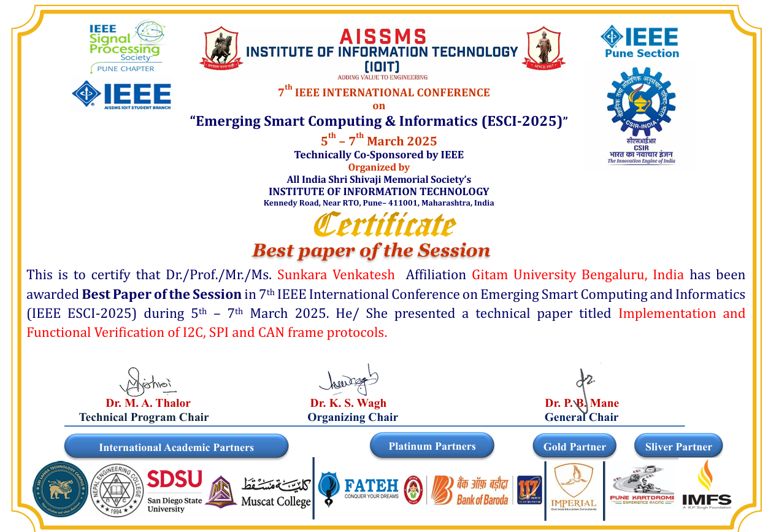
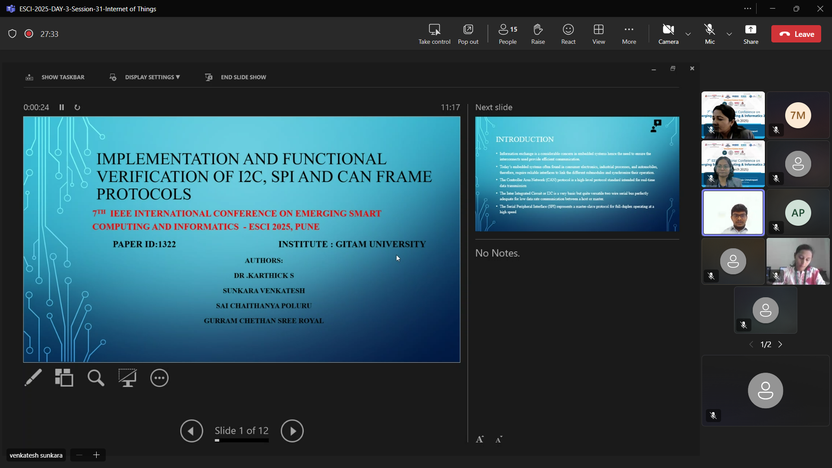
HIGHLIGHTS OF IEEE CONFERENCE ESCI 2025
5-7 March 2025

Slide 6
Literature Survey
S.NO | Title of paper | year | Authors | Key findings | Drawbacks
1. | Module Implementation and Simulation of Timing Constraint Check Function of I2C Protocol Using Verilog | 2023 | Jun-Cheol Lee; Tae-Oh Kim; Joo-Hyung Chae | methodology of Verilog modeling to check the compliance of the various timing parameters of the I2C-bus specification. | The research on implementing and simulating the I2C protocol's timing constraint check function in Verilog has several drawbacks. Simulations may not fully capture real-world conditions like signal noise or hardware limitations.
2. | Implementation Of I2C Protocol With Adaptive Baud Rate Using Verilog | April 2024 | Naveen RS; Sanjay S; Senthil Murugan A; Surya Prakash M; Mukuntharaj C | Verilog-based I2C controller, with its adaptive baud rate functionality, addresses the challenges posed by the varying baud rate requirements of devices in I2C communication. It not only improves versatility and compatibility but also simplifies system integration. The capability to dynamically adapt to device specifications significantly reduces the complexity of hardware design | The implementation of adaptive baud rate in I2C using Verilog increases design complexity, risks timing issues during dynamic adjustments, and may struggle to maintain stable communication across varying clock speeds.

Slide 7
Literature Survey
S.No | Title of paper | year | Author | Key findings | Drawbacks
3. | Functional Verification of SPI Protocol using UVM based on AMBA Architecture for Flash Memory Applications | 2023 | Shaila C K, G Manoj , Divya P.S. , Vijila.M | High-Speed Data Transfer: SPI enables fast, synchronous communication, ideal for real-time applications, Full-Duplex: SPI supports simultaneous data transmission and reception, boosting efficiency. | No Acknowledgment Mechanism: SPI lacks built-in error-checking or acknowledgment features.Limited Distance: SPI is not suitable for long-distance communication due to signal degradation.
4. | Low Cost FPGA Implementation of a SPI over High Speed Optical SerDes | 2018 | Peter Hobden and Saket Srivastava ,School of Engineering, University of Lincoln, United Kingdom | Multiple Slaves: SPI supports multiple slave devices, controlled via separate select lines (SS).Low Power Consumption: SPI is power-efficient, making it suitable for battery-powered embedded systems. | Complexity with Multiple Slaves: Managing multiple slave devices requires additional chip-select lines, increasing hardware complexity.No Multi-Master Support: SPI does not natively support multiple masters on the same bus.

Slide 8
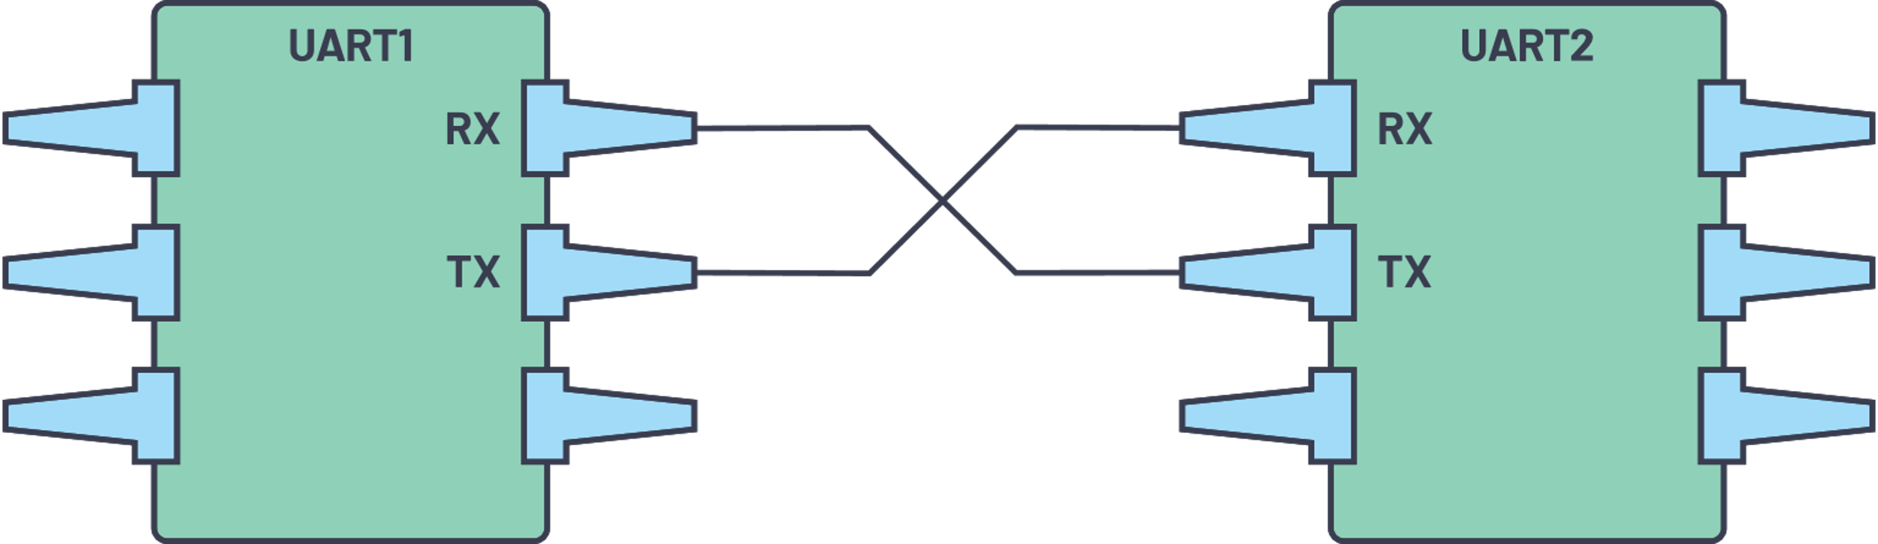
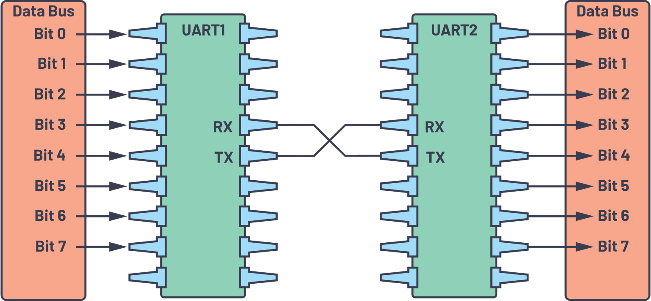
UART Protocol
UART stands for Universal Asynchronous Receiver/Transmitter. It’s not a communication protocol like SPI and I2C, but a physical circuit in a microcontroller, or a stand-alone IC. A UART’s main purpose is to transmit and receive serial data.
One of the best things about UART is that it only uses two wires to transmit data between devices.
In UART communication, two UARTs communicate directly with each other. The transmitting UART converts parallel data from a controlling device like a CPU into serial form, transmits it in serial to the receiving UART, which then converts the serial data back into parallel data for the receiving device. Only two wires are needed to transmit data between two UARTs. Data flows from the Tx pin of the transmitting UART to the Rx pin of the receiving UART:

Slide 9
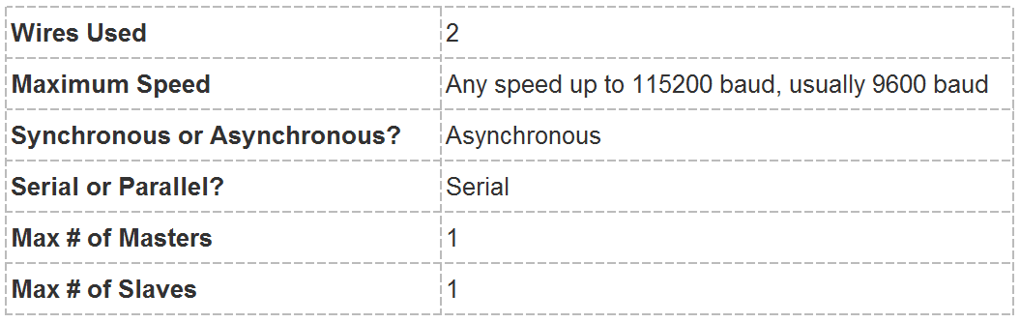
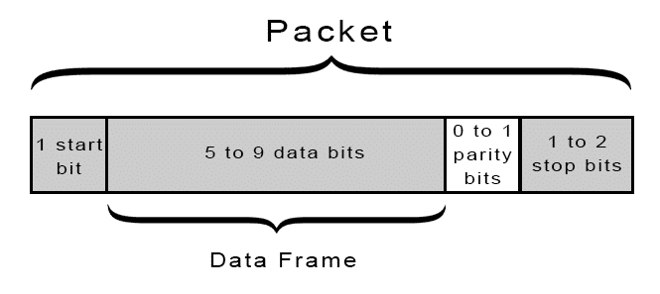
UART
UARTs transmit data asynchronously, which means there is no clock signal to synchronize the output of bits from the transmitting UART to the sampling of bits by the receiving UART. Instead of a clock signal, the transmitting UART adds start and stop bits to the data packet being transferred.
When the receiving UART detects a start bit, it starts to read the incoming bits at a specific frequency known as the baud rate.
Baud rate is a measure of the speed of data transfer, expressed in bits per second (bps). Both UARTs must operate at about the same baud rate. The baud rate between the transmitting and receiving UARTs can only differ by about 10% before the timing of bits gets too far off.
Both UARTs must also must be configured to transmit and receive the same data packet structure.

Slide 10

Methodology –UART
Theoretical research
understanding Working of UART
Data Transmission Analysis
Xilinx Vivado 2016.2 (Verilog)
Functional verification (Test Bench)
Simulated Result
Graphical Analysis
RTL Analysis

Slide 11
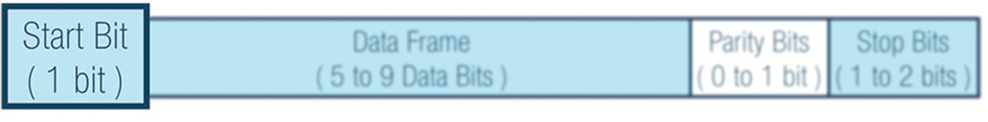
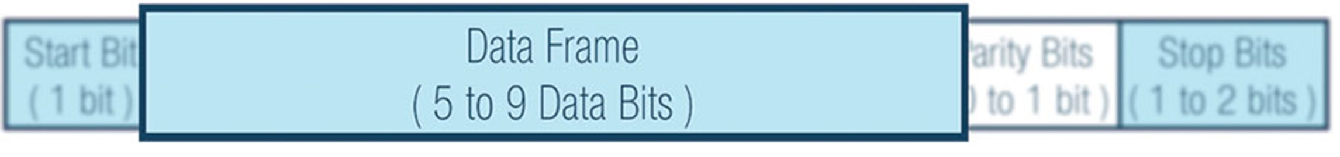
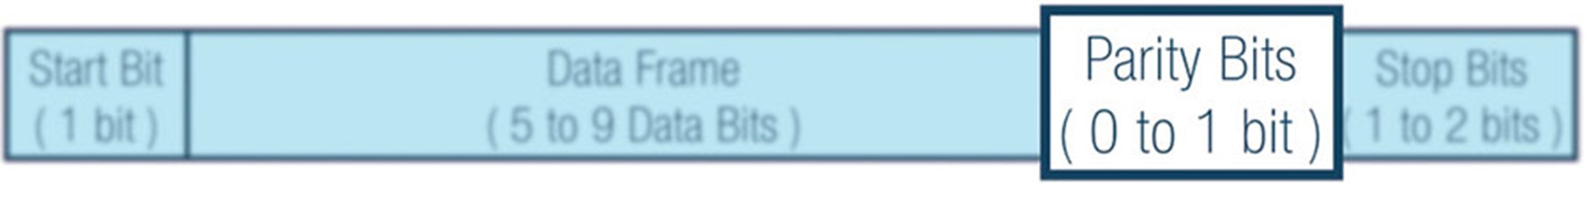
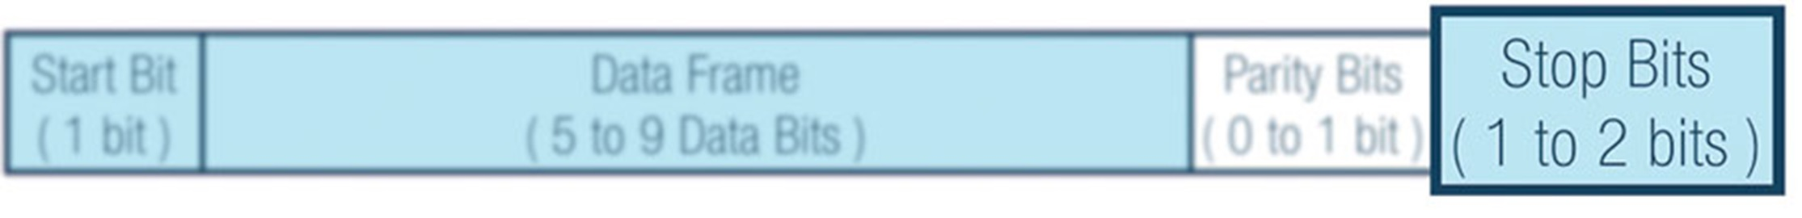
UART Steps

Slide 12

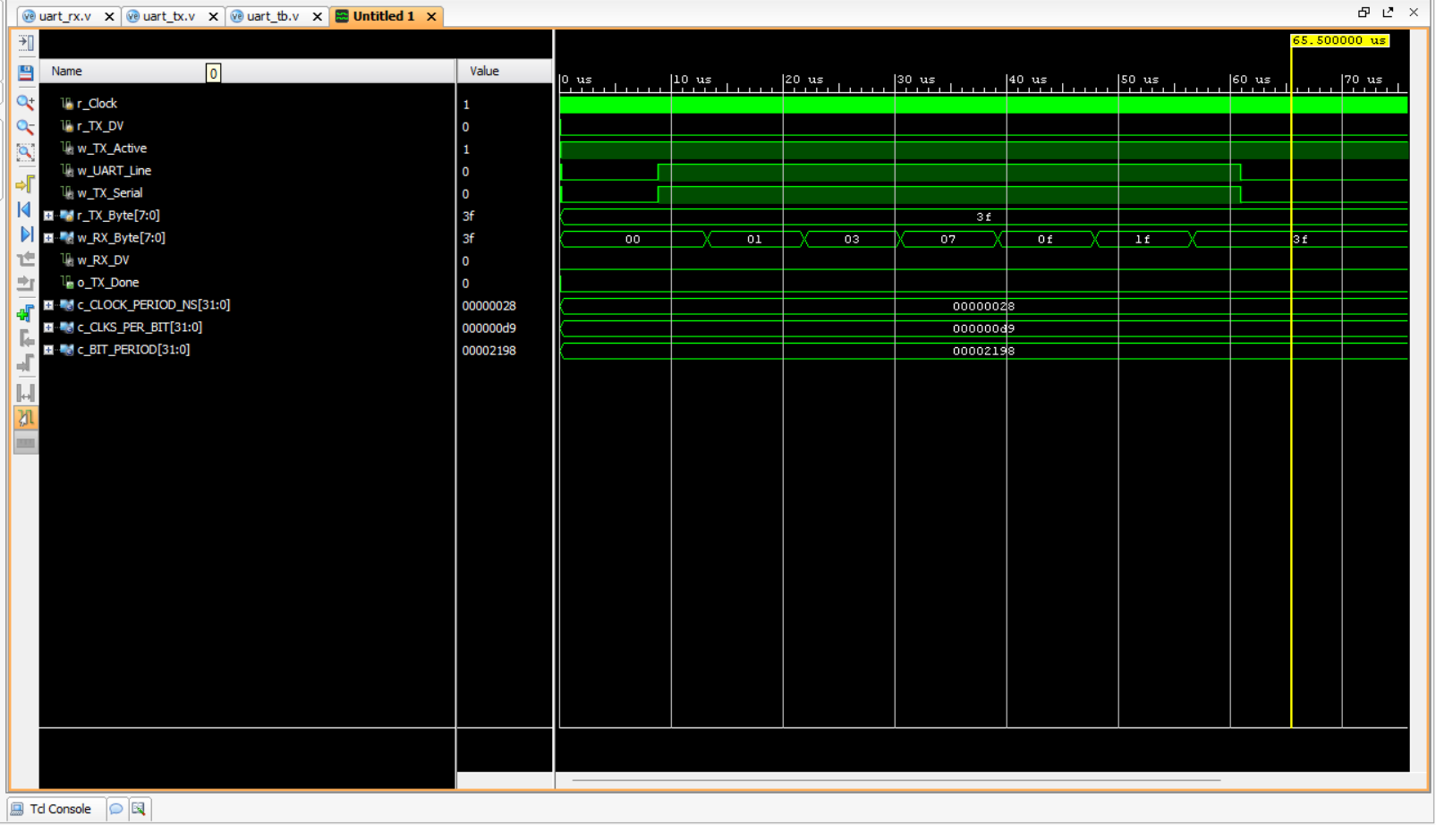
SIMULATION AND SYNTHESIS RESULT

Slide 13

Methodology –Flex Ray
Theoretical research
Understanding frame structure
Working Analysis
Xilinx Vivado 2016.2 (Verilog)
Functional verification (Testing )
Simulated Result
Graphical Analysis
RTL Analysis (Netlist Generation)

Slide 14
Flex Ray Protocol
Flex Ray is an automotive network communications protocol developed through the FlexRay Consortium to govern on-board automotive computing.
Flex Ray supports high data rates, up to 10 Mbit/s, explicitly supports both star and party line bus topologies, and it consist of two independent data channels for fault-tolerance. The bus operates on a time cycle, divided into two parts: the static segment and the dynamic segment.
The Flex Ray development is driven through leading core companies such as BMW, Daimler Chrysler, Freescale semiconductor, GM, NXP semiconductors, Robert Bosch, and Volkswagen.
The static segment is pre-allocated into slices for individual communication types, providing a stronger real-time guarantee than its predecessor CAN.
The dynamic segment operates more like CAN, with nodes taking control of the bus as available, allowing event-triggered behavior.

Slide 15
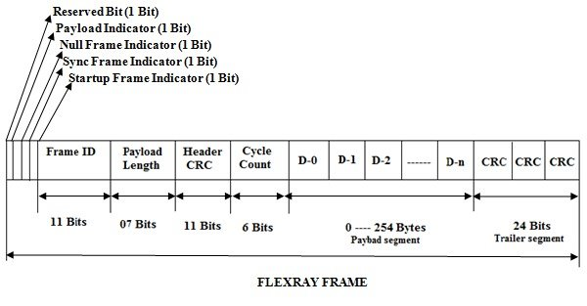
Flex Ray frame
A Flex Ray communication system consists of number of FR nodes and physical transmission medium (FR bus) for interconnecting all of the Flex Ray nodes.
FR nodes are also called as ECU, which is connected to a Flex Ray bus via a FR interface.
Flex Ray interface consist of communication Controller and one/two bus drivers depending up on the number of channels.
Basically, in FR communication system, as two channels for designing it can choose between single channel and dual channel configuration.
Based on the design the communication channels operate at the data rate of 10 Mbit/sec

Slide 16
FLEX RAY
Flex Ray frame consists of 3 main parts
3 Modes of Operation in Flex Ray
Flex Ray
Operating Modes
Header
Payload
Trailer
STARTUP Mode
STANDBY Mode
RUN mode

Slide 17
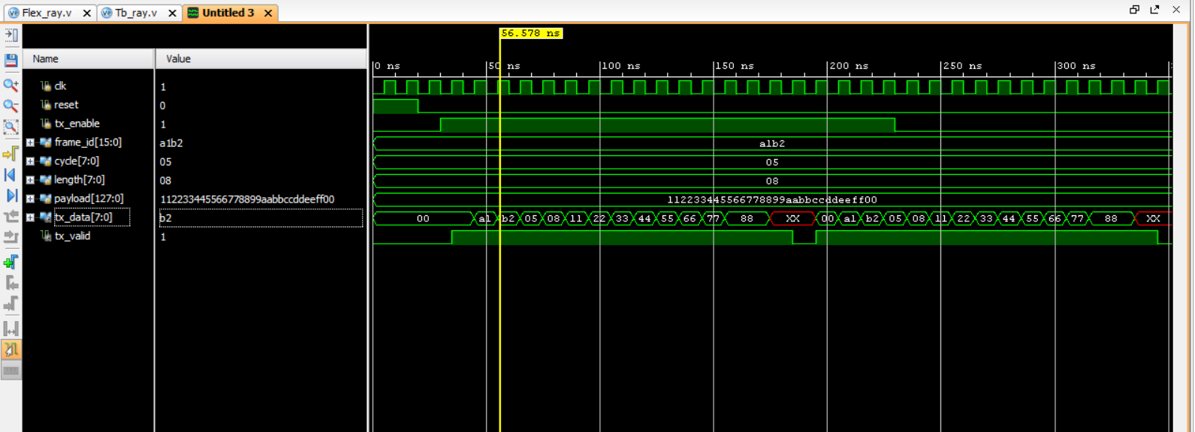
SIMULATION AND SYNTHESIS RESULT
INFO: [USF-XSim-97] XSim simulation ran for 1000ns
launch_simulation: Time (s): cpu = 00:00:02 ; elapsed = 00:00:08 .
Memory (MB): peak = 1733.727 ; gain = 0.000
Time taken to transfer given data : 35 -40 ns

Slide 18

Comparison between Protocols
Feature | I2C | SPI | CAN | UART | FlexRay
Type | Serial, Multi-Master | Serial, Master-Slave | Serial, Multi-Master, Bus | Serial, Point-to-Point | Serial, Multi-Master, Time-Triggered
Speed | Up to 3.4 Mbps | Up to 10 Mbps | 1 Mbps (CAN 2.0), 5 Mbps (FD) | Up to 1 Mbps | Max 10 Mbps
Topology | Multi-Master/Slave | Master-Slave | Multi-node Bus | Point-to-Point | Star/Bus
Complexity | Moderate | Simple | Moderate to High | Simple | High
Cost | Low | Low to Moderate | Moderate | Low | High
Use Cases | Sensors, EEPROMs | Displays, ADC, Flash | Automotive, Industrial | Serial Links, Modules | Automotive Safety, Aerospace
Synchronization | Master Clock | Master Clock | Self-clocked | Asynchronous | Synchronized
Fault Tolerance | No | No | Yes | No | Yes

Slide 19
Conclusion & Future Work
Summary and Conclusion
The project involves the design and implementation of UART and Flex Ray communication protocols using Verilog. These protocols were developed in compliance with industry standards for data transfer, signal integrity, and timing.
The functionality of each protocol was verified through simulation and waveform analysis. UART for reliable serial transmission, and Flex Ray protocol is crucial for functional verification in Verilog as it ensures deterministic, high-speed, and fault-tolerant communication in automotive and safety-critical systems.
The verification of the SPI, I2C, UART, CAN and Flex Ray protocols in the logic design phase demonstrates their reliability and adherence to communication standards.
Future Work
The expansion of this project will result in producing an IEEE paper which details UART and FlexRay protocol implementation together with functional verification testing. The paper conducts a comprehensive breakdown of protocol design while examining simulation outcomes and verification strategies to deliver scientific contributions for embedded as well as automotive communication systems.

Slide 20
Contribution
Team Progress and Movement
Initial Progress: Researched the UART and Flex Ray protocols gathered specifications, and developed the initial Verilog design.
Mid-Progress: Completed the first set of simulations for the protocols, refining the code to ensure error detection works as expected. Integrated feedback from guide the team for improvements. And also, we made IEEE Paper and presented at ESCI 2025 International Conference.
Final Progress: Finalized the protocols design and ensured successful simulation waveforms, prepared the GitHub repository for final submission, and contributed to the final report documentation and poster design.
Individual Contribution
Key contributions: Sunkara Venkatesh
Implemented the FlexRay frame protocol in Verilog and configured synchronization mechanisms.
Contributed to writing the research paper.
Created and presented PPT for the project to be used for demonstrations and conference submissions.
Key contributions : Poluru Sai Chaithanya
Implemented the UART protocol using Verilog in Vivado 2016.2.
Developed testbenches for UART and verified functionality through waveform analysis.
Prepared the detailed project report, documenting methodologies, results, and analysis.
Key contributions: Gurram Chethan Sree Royal
Conducted testing and debugging for both UART and Flex Ray implementations to ensure error-free transmission.
Performed comparative analysis of UART and Flex Ray with existing protocols like I2C, SPI, and CAN.
Designed the project poster for exhibition.

Slide 21
THANK YOU
Have a Great Day !

